Slide 1
Uncovering Factors Patients Use to Evaluate Meaningful Response to Migraine Treatment
Erin m. Buchanan, Ph.D.

Slide 2

Who am I?
Statistician
Professor of Cognitive Analytics
Secret Scale Ninja
Awesome people I work with

Slide 3


Research Team
Addie Wikowsky, Graduate Student, Missouri State University
Arielle Cunningham, Graduate Student, Missouri State University
Heather Manley, Clinvest Research
Jim Sly, Clinvest Research
Ryan Cady, Clinvest Research

Slide 4
What is a Headache?
Head pain that is unpleasant, ranging from mild to severe
Pressure and aching
Triggers include stress, anxiety, sinus
Nearly everyone experiences these

Slide 5
What is migraine?
Often characterized as an “attack”
Moderate to severe pain
Comorbid with: visual disturbances, nausea, vomiting, sensitivity to light/Sound/other, Auras
~12% of the population experiences these

Slide 6
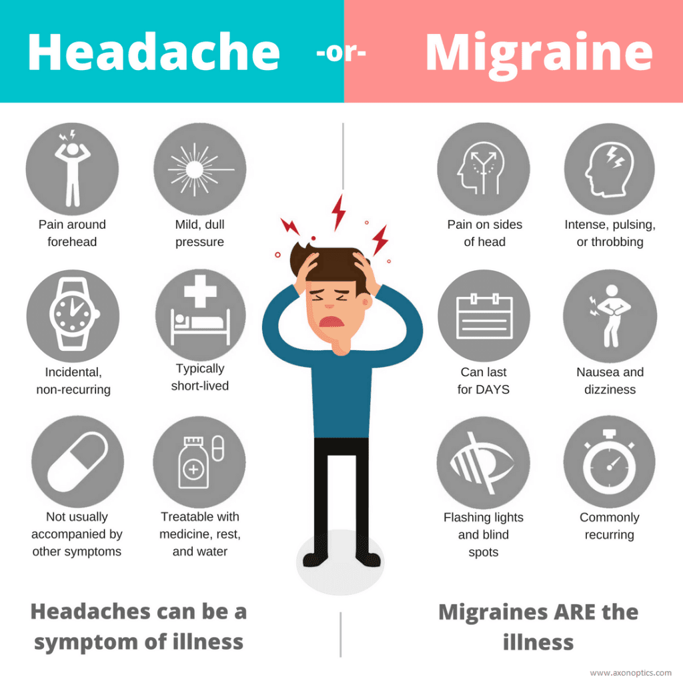

Slide 7
Fast Facts
3rd most prevalent illness in the world
A woman’s illness
Often 1-2 attacks per month, others are chronic with 15+ per month
Serious impacts on work, family, and daily life

Slide 8
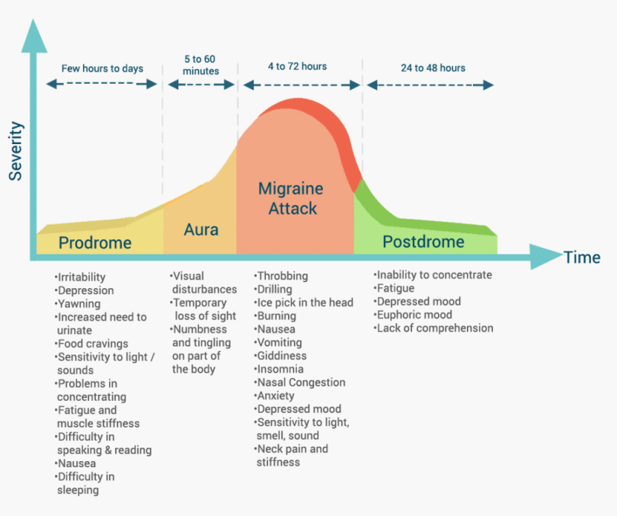

Slide 9
Objectives of the study
To establish factors which are most important to patients when appraising the efficacy of treatment (phase 1/2)
To develop a patient reported outcome measure to evaluate headache meaningful response to headache treatment regimens (Phase 2/3)

Slide 10
Why is there a need?
Scale
Migraine Disability Assessment (MIDAS) | 5 items measuring loss of productivity across work and social/family
Headache Impact Test (HIT-6) | 6 items measuring lost work time, pain severity, fatigue
Migraine Specific Quality of Life (MSQ) | 14 items measuring quality of life in roles and emotion

Slide 11
Why is there a need?
Development of these scales is often Doctor/Researcher oriented
Focus, Readability, etc.
Scales are often designed for only one facet of Migraine
Cost of Scales can be prohibitive
Number of Therapeutic options is on the rise

Slide 12
Phase 1 – Patients tell us what matters
Developed a semi-structured interview:
Subject Matter Experts(Clinvest Team, Patient Advocate, Migraine Specialists)
Mix of open ended and ranking type questions
Thematic domains of pain, productivity, social with the opportunity for others
90 minutes and payment of $200

Slide 13
Phase 1 – Patients tell us what matters
Participants were 10 migraine sufferers
80% Female
~47.60 years old (SD = 13.32)
70% Chronic Migraine
50% were taking more than 5 prophylactic medications
60% Employed

Slide 14
Phase 1 – Patients tell us what matters
Two Main Results:
Rating of importance for our preselected themes
Thematic Analysis of open ended responses

Slide 15
Phase 1 – Patients tell us what matters

Slide 16
Phase 1 – Patients tell us what matters
Code Category | Examples
Associated Symptoms | Decrease symptoms, Photophobia
Concentration | Clear head, Not thinking about head pain
Doctor | Actual access to the provider Need for more options
Education | Be own biggest advocate Articulate problems to provider Help patients understand full symptoms Other treatment options
Financial/Insurance | Monthly restrictions What’s covered on plan Cost to treat migraine
Frequency | Fewer higher pain days Less attacks Headache free

Slide 17
Phase 1 – Patients tell us what matters
Medication | Knowing it will work, Less meds per day More options on the market Worries about safety
Normal Functioning | Emotional consistency, Exercise Schedule events, Take a shower Cannot interact, Activity level
Pain | A cure, Less pain, Relief
Productivity | Do not have to miss job, Sick days Daily accomplishments, Do housework
Self-Worth | Enjoy activities, Perception of competences Satisfaction
Social | Not isolate friends, Ruin relationship Go out to each, Family, Do activities

Slide 19
Phase 1 – Patients tell us what matters
Normal Functioning and Social Functioning were most frequently discussed
In contrast to Frequency and Pain focus in Clinical trials
Gives insight to areas for future exploration

Slide 20
Phase 2 – Using EFA to explore themes
Two Important Development Phases:
Scale Creation
Scale Assessment

Slide 21
Phase 2 – Using EFA to explore themes
Scale Creation
Use simple language
Ask only one question
Careful with negatives
Multiple assessment alternatives

Slide 22
Phase 2 – Using EFA to explore themes
Scale Creation
Team brainstormed ~ 200 questions assessing the 12 themes
Normal Functioning: My activity level has increased because my migraine attacks have improved.
Social: I have been able to schedule events with family and friends, which means I am improving.
Frequency: I now have fewer migraine attacks.

Slide 23
Phase 2 – Using EFA to explore themes
Scale Creation
Team brainstormed ~ 200 questions assessing the 12 themes
Normal Functioning: My activity level has increased because my migraine attacks have improved.
Social: I have been able to schedule events with family and friends, which means I am improving.
Frequency: I now have fewer migraine attacks.

Slide 24
Phase 2 – Using EFA to explore themes
Scale Creation
Special considerations were made for the Doctor, Education, and Financial/Insurance Themes
Doctor: My medical provider is knowledgeable of migraine.
Education: My friends understand my migraine symptoms and limitations.
Financial: Adequate treatment of my migraine is a financial burden to me.

Slide 25
Phase 2 – Using EFA to explore themes
100 Participants took the online survey for $75
Average time completion was an Hour
84% Female
38.94 years old (SD = 13.32)
70% episodic migraine

Slide 26
Phase 2 – Using EFA to explore themes
Scale Assessment
For each Theme an Exploratory Factor Analysis (EFA) was examined
EFA is a statistical tool that allows you to uncover the underlying structure of the data
Here the Analysis was also used for data reduction

Slide 27
Phase 2 – Using EFA to explore themes
Q4
Q1
Social
Pain
Q5
Q2
Q6
Q3

Slide 28
Phase 2 – Using EFA to explore themes
Scale Assessment – The EFA Rules
Could be multiple subscales
Items had to correlate > .40 with their factor
Items had to be rated as “useful” by 75% of participants
Then top 6 correlated items were selected

Slide 29
Phase 2 – Using EFA to explore themes
Theme | Original Questions | High Loadings | Important to Patients
Associated Symptoms | 13 | 8 | 7
Concentration | 9 | 7 | 6
Doctor | 13 | 13 | 13
Education | 15 | 10 | 10
Financial/Insurance | 17 | 16 | 15
Frequency | 19 | 17 | 17
Medication/Financial | 22 | 14 | 13
Normal Functioning | 27 | 27 | 19
Pain | 17 | 13 | 13
Productivity | 24 | 17 | 10
Self-Worth | 14 | 12 | 6
Social | 20 | 16 | 8

Slide 30
Phase 2 – Using EFA to explore themes
We found a smaller subset of items to examine with a larger patient population
These items were mostly endorsed by patients with a few exceptions

Slide 31
Phase 3 – confirming scale structure
Currently, data collection is ongoing for confirming scale structure
Goal is for 200 patients to complete the reduced set of items
Analysis will be an EFA on all items to find the most highly correlated items for each theme
The final scale will be compared to other “gold standard” measures

Slide 32
Phase 3 – confirming scale structure
The end goal for this project is a short questionnaire that can be used in research or the Doctor’s office to assessment treatment response
Patients can examine score change over time to assess their improvements

Slide 33
Next steps
Once the short form scale is developed, it should be evaluated with confirmatory procedures, such as a structural equation model
Then the scale can be used in research, clinical trials, and in the doctor’s office
A larger item pool can be used to create patient profiles and tracking

Slide 34
Next Steps

Slide 35
Takeaways
Migraine is an multi-faceted illness with many factors to consider other than pain and frequency
Data analytics – both qualitative and quantitative – can be used to develop tools for better patient outcomes

Slide 36

Questions Thank you!

